Slide 1
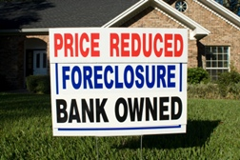
Predicting the Impact of the Great Recession
on Housing Prices in Ames, Iowa
David Kanevsky, DSB 318 2024-04-19

Slide 2
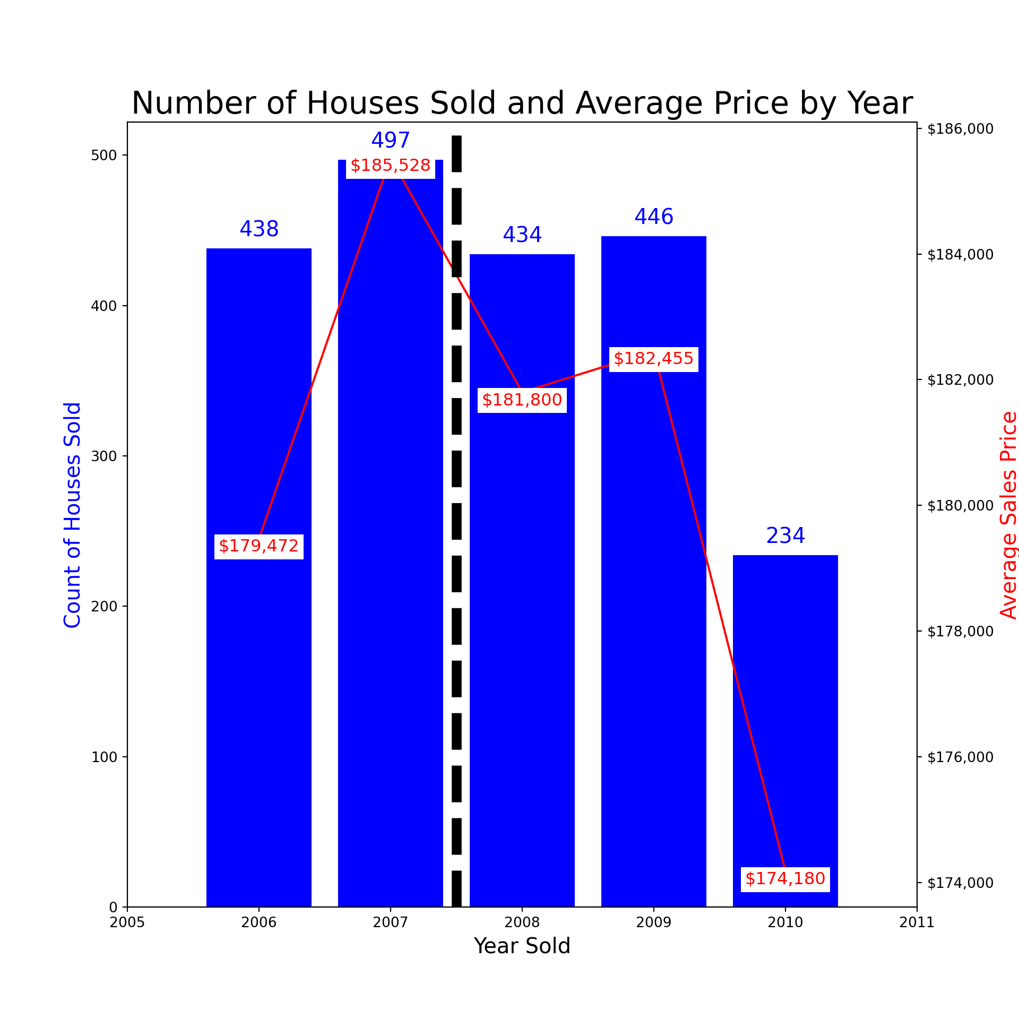
Notes:
Dip from 2007 to 2008, with slight rebound in 2009 before dropping in 2010

Slide 3
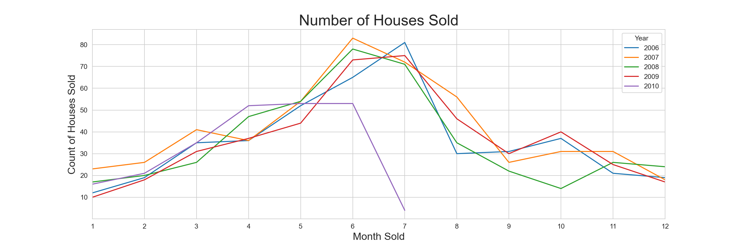
Notes:
Data from 2010 incomplete. Ends in July 2010. Even July 2010 may be incomplete for the month – fewest sold that month.
Seasonality to housing sales. More sales in June/July than other months
But not clear that sales in crisis are lower than pre-crisis. If that was the case, we’d see the blue/orange lines for 2006-2007 consistently higher than the others.

Slide 4
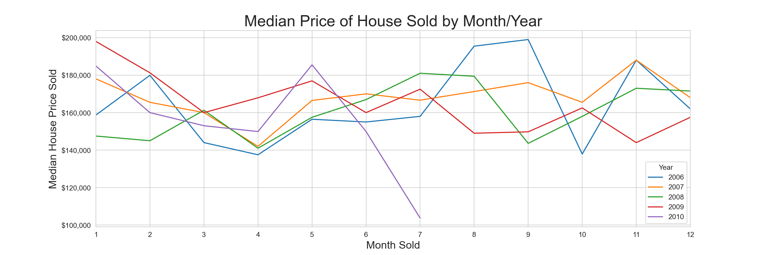
Notes:
Also looked at mean price by month/year and similar data. No consistency.
Would expect blue/orange (07-08) to be higher than others, but doesn’t show up here.

Slide 5
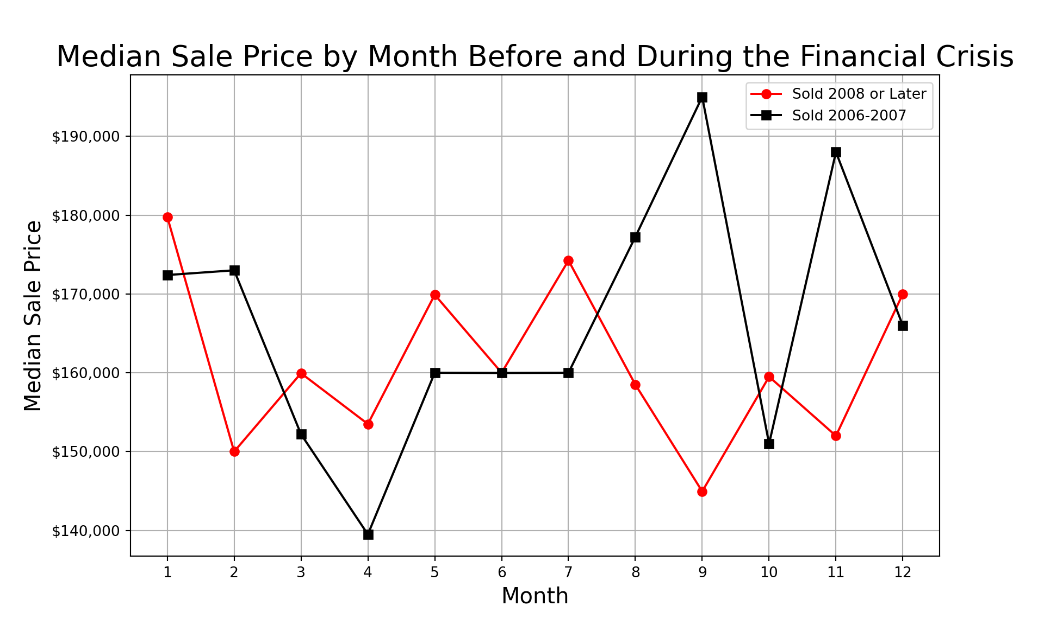
Notes:
If post-2008 crisis affected housing prices, we’d expect to see red line below black line. But in 7 of 12 months, prices higher post-2008, 4 higher pre-2008, and 1 tied.

Slide 6
Notes:
Overall, selling during the financial crisis is one of the 2nd least correlated variables with price at just -0.14. In fact the unique identifier has a higher correlation (-0.51)
Best performing model (all numeric + 7 categorical) – sold in crisis coefficient is $1,379.60 more than not (all other variables held constant).
If I hold out the dummy variable I created “sold in crisis,” it improves the model’s RMSE by $100.
The initial model I submitted was on the lr_numeric – all the numeric data. I tried to do the one with the lowest RMSE

Slide 7
Conclusions and Recommendations
A house being sold during the financial crisis (2008 or later) has limited impact on predicting the price of a house in Ames, IA in part because other variables like the year it’s sold is accounting for it in the model. We’re better off not including that variable in the model.
To really see the impact of the financial crisis on housing prices, would want to look at a longer time window – before 2006 and after 2010, to look at impact of financial crisis on housing prices.
Would also want to adjust housing prices to reflect changes in CPI / purchasing power. For example, 2009 prices slightly higher than 2008 and 2006 (but lower than 2007), but higher prices in 2009 may be lower in purchase power due to inflation.

